Slide 1

Hypothesis: Within the U.S., industrialized regions in the U.S. are the most prone to cancer incidence and cancer mortalities
Question: Do non biological variables explain the differences between cancer incidence and cancer mortalities?

Slide 2
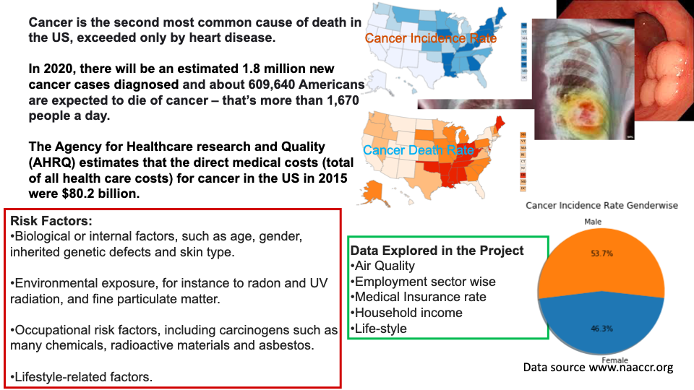
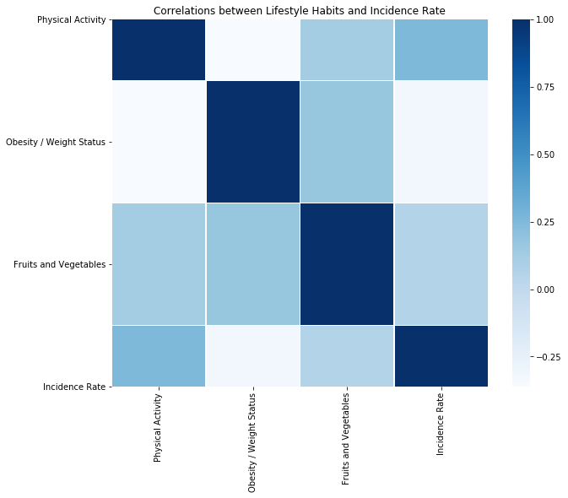
Obesity/Weight has a negative correlation with Incidence Rates for the top states
Physical activity and fruits and vegetables consumption has an almost constant slope for the correlation with incidence rates.
Conclusion: there is no correlation between physical activity and fruits and vegetables consumption. However, incidence rates and obesity/weight has an inverse relationship, that is to say that as incidence rates is associated with the non-obese and lower weights

Slide 3
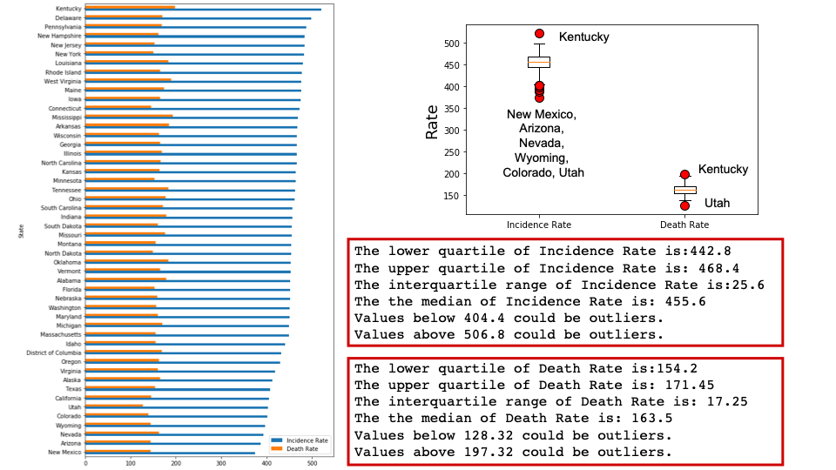

Slide 4
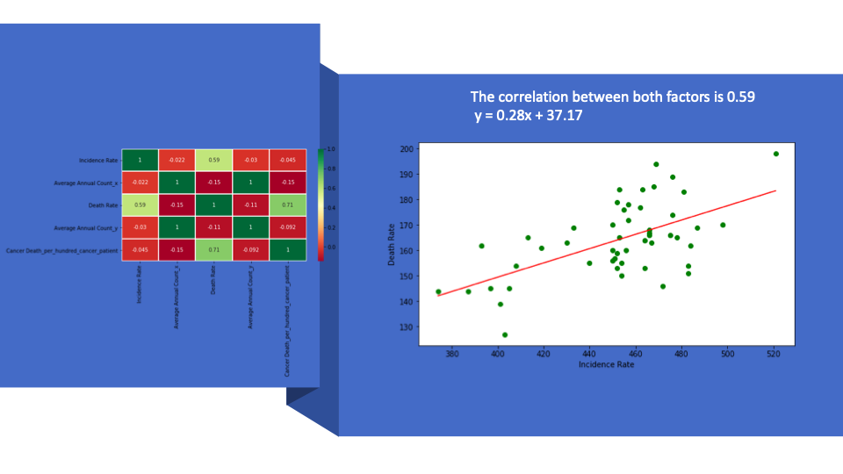

Slide 5
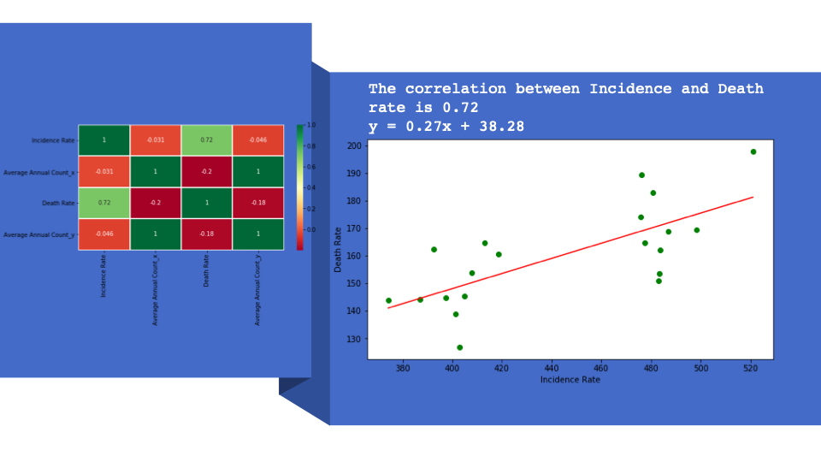

Slide 6
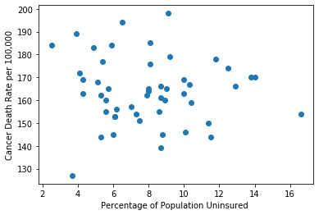
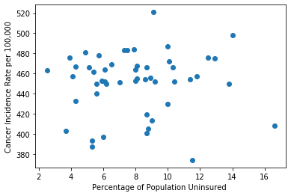
Cancer Statistics

Slide 7
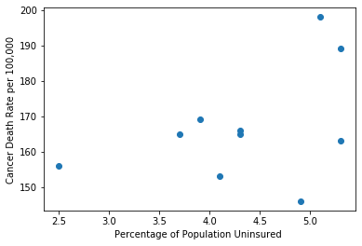
Top 10 Most Insured States
The pearson correlation between both factors is 0.43

Slide 8
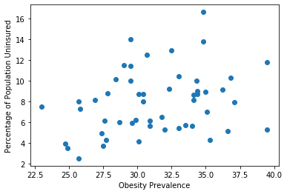
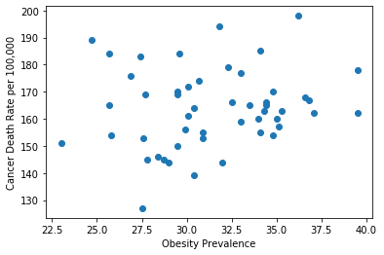
What about Obesity?
The pearson correlation between both factors is 0.29 (moderate correlation)

Slide 9
David’s Data Process
-Fairly simply process for my data comparisons
-Was able to find datasets that had obesity rates and health insurance coverage rates.
-My datasets were relatively clean, so I was able to easily compare them with the cancer data.
- I wanted to look at county-level data, but was unable to find a usable dataset.

Slide 10
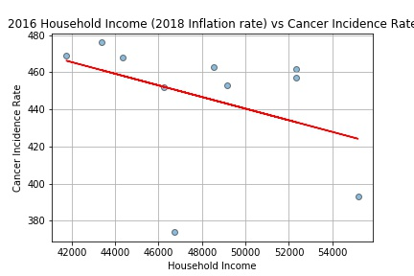
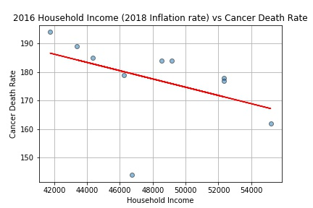
2016 Household Income vs Cancer Incidence and Death Rate

Slide 11
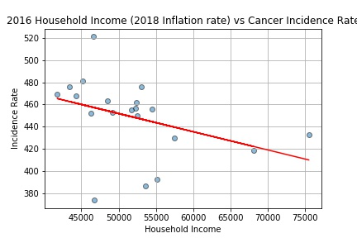
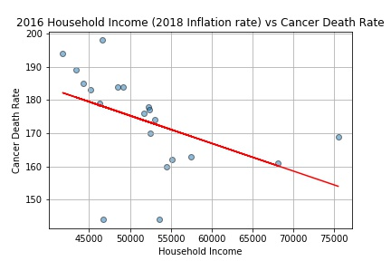
2016 Household Income vs Cancer Incidence and Death Rate Cont.

Slide 12
Manufacturing Employment & Cancer Incidence Rates
The US Census Bureau and Department of Labor collect employment figures and categorizes these into sections in the North American Industry Classification System
We were able to take NAICS data on a number of manufacturing industries and combine them with total labor force in each state in 2016 to find the percentage of people employed in manufacturing in each state. We could then see if there was any correlation between the manufacturing employment and incidence rates. We found:
The pearson correlation between percentage of workers in all manufacturing in all states and cancer incidence rate is 0.16.
The pearson correlation between chemical manufacturing workers and cancer incidence rate is 0.4.
The pearson correlation between the percentage of all manufacturing workers and cancer incidence rate in the 10 states with the lowest deaths per 100 cancer patients is 0.22
The pearson correlation between the percentage of coal & petroleum manufacturing workers and cancer incidence rate in the 20 states with the highest deaths per 100 cancer patients is 0.31
The pearson correlation between the percentage of chemical manufacturing workers and cancer incidence rate in the 20 states with the highest deaths per 100 cancer patients is 0.6

Slide 13
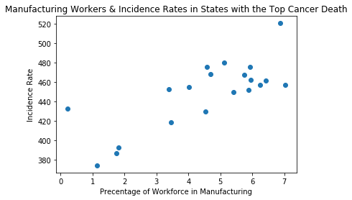
The pearson correlation between the percentage of a workforce in manufacturing and the cancer incidence rate is 0.77.

Slide 14

Cancer and Air Quality:
In 2016, lung cancer was the leading cause of cancer deaths worldwide
Outdoor air pollution and particulate matter have been classified as carcinogenic by the International Agency for Research on Cancer.
Air quality index is an index used for reporting air quality data. It is comprised of concentrations of sulfur dioxide,nitrogen dioxide,carbon monoxide,ozone, and atmospheric particulate matter that has a diameter of less than 10 micrometers and 2.5 micrometers.
2.5 micrometers size comparison-3% diameter of human hair
Particulate matter is a mixture of solid particles and liquid droplets that are often the result of complex chemical reactions due to release from automobiles, power plants, and industries.
Extracted annual air quality data by state and county from the EPA’s website for 2012-2016.
Averaged air quality data by state for each year.
Averaged air quality data by state among all years (2012-2016)

Slide 15
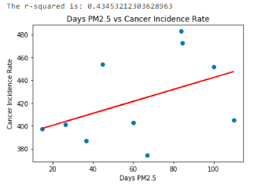
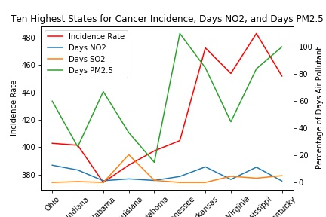
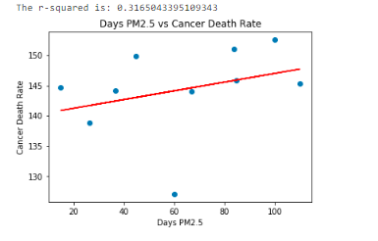
Air Pollutants,Cancer Incidence Rates and Cancer Death Rates
Takeaways: As cancer incidence rates increase in top ten states, the number of days that PM2.5 is the main air pollutant also increases. There is a stronger correlation between cancer incidence rate and PM2.5 than cancer death rate

Slide 16
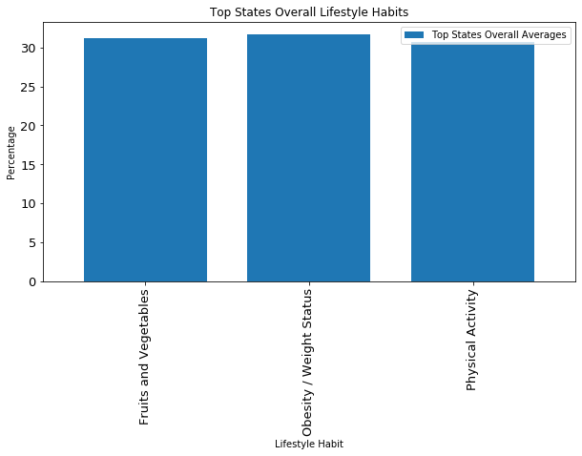
Lifestyle Habits
The lifestyle data sets used are from CDC’s Behavioral Risk Factor Surveillance System
Among the top states, obesity/weight has the overall highest average percentage rate.

Slide 17
Correlation of cancer incidence rates and lifestyle habits
Conclusion:
Obesity/Weight status is the only factor that has a negative correlation with cancer incidence rate per the data from CDC that was used. This suggests that the incidence rate is high when obesity/weight percentage of the population is low.
Physical activity and nutrition have a positive correlation which suggests that when incidence rates are high, the population’s physical activity and nutrition intake is high.

Slide 18
Conclusions
There is a correlation between percentage of manufacturing jobs and cancer incidence rate in states with the highest death rate, chemical manufacturing in particular shows a strong correlation. This suggests that byproduct of these two manufacturing products are carcinogenic in nature. This is also in line with a correlation between PM2.5 and air quality.
Additional analyses performed could include creating a graph to plot all factors together against cancer incidence and cancer death rate. In addition, digging deeper into the states where we see slight correlations between various factors and doing analyses by county.
Limitations: Potentially not enough lag time between when data for risk factors was collected vs when cancer death and incidence rates were reported.

